Slide 1
Looking after your device

Slide 2
Complete the statements about the Kawa of Care for your device by matching section A and B.
You can draw an arrow to match the sentence starter in Section A to the end of the sentence in Section B
Section A
If you leave the classroom or home
Work near a wall
No food or drink
Keep your device
If you are working on the floor
Section B
if you are charging your device
is allowed near your device
away from the edges of tables
choose a space where people can see you
lock your device in a safe place

Slide 3
Looking after your device quiz
Should you eat and drink around your device?
No

Slide 4
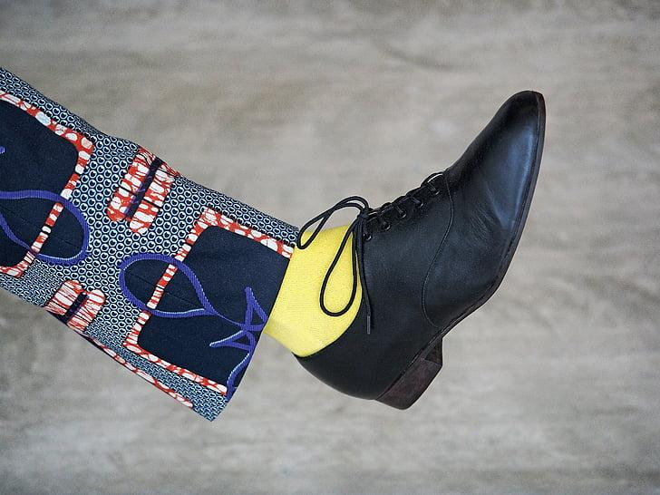
Looking after your device quiz
When working on the floor, should you stay away from where others are walking?
Yes

Slide 5
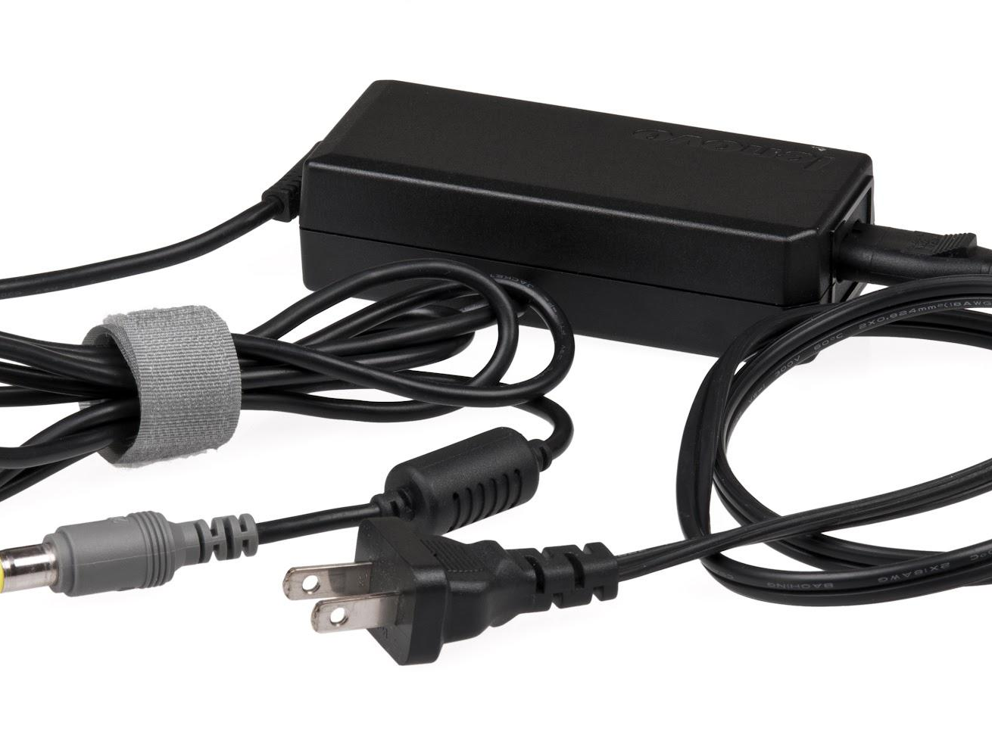
Looking after your device quiz
When charging your device, should the cable be lying on the floor?
No

Slide 6
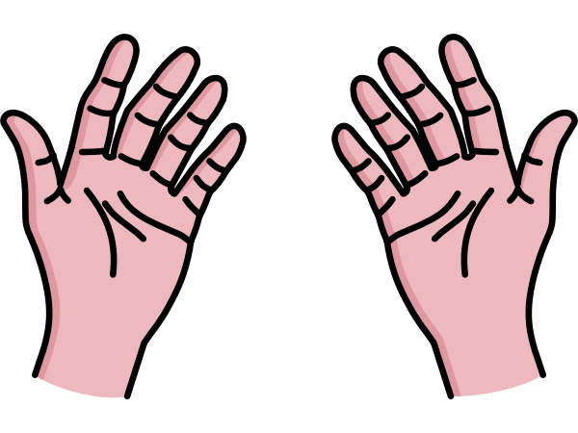
Looking after your device quiz
Do you use one hand to carry your device?
No

Slide 7
Looking after your device quiz
Should you carry your device by the lid?
No

Slide 8
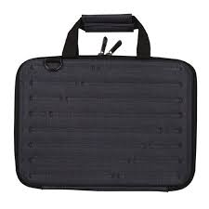
Looking after your device quiz
Should you always carry your device in its bag when you are outside?
Yes

Slide 9
Looking after your device quiz
Share your answers with your teacher before posting on your blog.
Discuss your quiz answers with your peers to share your ideas about looking after you device.

